Slide 1
The New Testament IS A PATTERN
For the Worship of the Church (2)
Part 7b

Slide 2
REVIEW

Slide 3
To Successfully Follow THE PATTERN:
It must currently exist
It must be complete
It must be deliberately revealed
It must be understandable
It must be intended for others to observe
It must be adopted and obeyed
It can only be met with an approved agreement when fully replicated

Slide 4
Lord’s Supper
WORSHIP

Slide 5
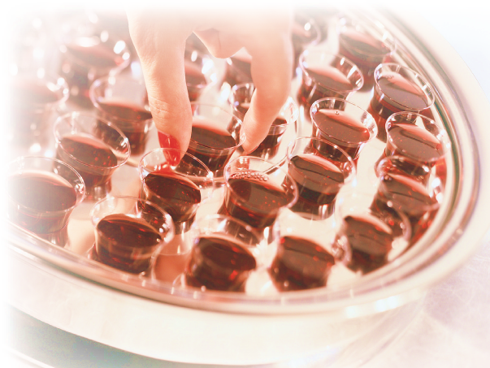
Since The New Testament Is Our Pattern
There is a pattern for:
The worship of the church (Jn. 4:23, 24)
Observing the Lord’s Supper (Acts 2:42; 20:7)
Memorial
Unleavened bread
Fruit of the vine
Taken in kingdom
In the local assembly
On the first day of the week
LK 22:19
MK 14:12-25
MK 14:25
1COR 11:18-26
ACTS 20:7-12

Slide 6
How Churches Violate The Pattern
Catholics
Many members partake of only the bread while the priests partakes of both the bread and cup
Various Denominations
Offer the Lord’s Supper at all different times (Saturday, quarterly, annually)
Jehovah’s Witnesses seek to offer it on the actual Passover date which violates Acts 2:42; 20:6, 7
change the elements (leavened bread, alcoholic wine, water)

Slide 7
Mormons
Use water and bread
“For, behold, I say unto you, that it mattereth not what ye shall eat or what ye shall drink when ye partake of the sacrament, if it so be that ye do it with an eye single to my glory—remembering unto the Father my body which was laid down for you, and my blood which was shed for the remission of your sins” (Doctrines and Covenants 27:2)
“Water is now used instead of wine in the sacramental services of the Church” (www.lds.org/scriptures/dc-testament/dc/27?lang=eng)

Slide 8
Paul Versus Mormon’s Moroni
Mormons: “…it mattereth not what ye shall eat or what ye shall drink when ye partake of the sacrament…” (DC 27:2)
Paul:
“For as often as you eat this bread and drink this cup, you proclaim the Lord’s death till He comes” (1 Cor. 11:26)
No authority for any other kind than “this bread” and “this cup” to proclaim the Lord’s death

Slide 9
Paul Versus Mormon’s Moroni
Mormons: “…it mattereth not what ye shall eat or what ye shall drink when ye partake of the sacrament…” (DC 27:2)
Paul:
“For he who eats and drinks in an unworthy manner eats and drinks judgment to himself, not discerning the Lord’s body” (1 Cor. 11:29)
The manner in which the Supper is taken does matter!

Slide 10
Paul Versus Mormon’s Moroni
Mormons: “…it mattereth not what ye shall eat or what ye shall drink when ye partake of the sacrament…” (DC 27:2)
Paul:
“And whatever you do in word or deed, do all in the name of the Lord Jesus, giving thanks to God the Father through Him” (Col. 3:17)

Slide 11
Paul Versus Mormon’s Moroni
Mormons: “…it mattereth not what ye shall eat or what ye shall drink when ye partake of the sacrament…” (DC 27:2)
Paul:
“But even if we, or an angel from heaven, preach any other gospel to you than what we have preached to you, let him be accursed” (Gal. 1:8)

Slide 12
Mk. 14:26; Eph. 5:19; etc.
Singing
Lord’s Supper
WORSHIP

Slide 13
1 Cor. 16:1, 2
Singing
Lord’s Supper
Giving
WORSHIP

Slide 14
Singing
Lord’s Supper
Giving
WORSHIP
Prayers
Acts 1:14; 2:42; etc.

Slide 15
Singing
Lord’s Supper
Giving
WORSHIP
Preaching
Prayers
Acts 2:42; 20:7; etc.

Slide 16
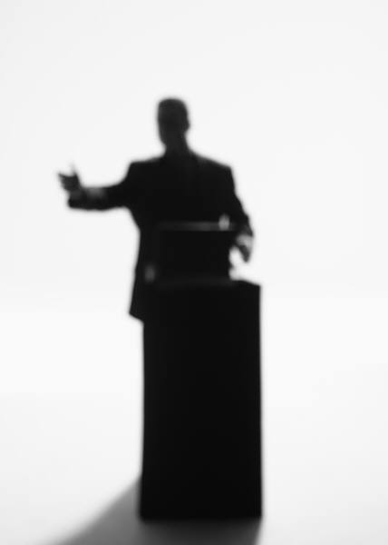
Preaching After The Pattern
The word (2 Tim. 4:2; 1 Pet. 4:11)
Public and house studies (Acts 20:20)
The Christ (Acts 8:5)
The kingdom (Acts 20:25)
The whole counsel of God (Acts 20:26, 27)
Expounding the scriptures (Lk. 24:27, 32; Neh. 8:8)

Slide 17
It Is YOUR Responsibility to Be A Member Of A CHURCH WHICH HONORS CHRIST’S PATTERN

Slide 18
Matthew 15:13, 14
¹³ But He answered and said, "Every plant which My heavenly Father has not planted will be uprooted.
¹⁴ "Let them alone. They are blind leaders of the blind. And if the blind leads the blind, both will fall into a ditch."

Slide 19
2 Timothy 1:13
¹³ Hold fast the pattern of sound words which you have heard from me, in faith and love which are in Christ Jesus.
IN CHRIST
Paul’s Preaching
Pattern of Sound Words

